Slide 1
Data Visualization with Power BI
PRESENTING BY GROUP - 3
Amit Patange
Divya Uike
Natasha Joshi
Arafat Mulla
Mruganka Mahendra Shende
avinash mundhe
Devesh Rajesh Mehare
Nikhil Kohale
Ramnath Soudagar Gaikwad

Slide 2
Introduction to Data Visualization
Data visualization is a powerful tool that transforms raw data into meaningful insights, enabling better decision-making and understanding of complex information. Power BI, a leading business intelligence Tool and data visualization platform, empowers users to create compelling visualizations that communicate insights effectively.

Slide 3
Role of Power BI:
Power BI is a comprehensive tool that allows users to connect to various data sources, transform and model data, and design interactive visualizations.
It offers a user-friendly interface with drag-and-drop functionality, making it accessible to both technical and non-technical users.
Power BI enables the creation of interactive dashboards and reports, fostering collaborative data exploration and sharing

Slide 4
Benefits of Power BI Data Visualization:
Interactivity: Power BI visualizations are interactive, enabling users to explore data, filter information, and drill down into details with ease.
Real-time Insights: Visualizations can display real-time data, providing up-to-date insights for timely decision-making.
Data Integration: Power BI integrates with various data sources, allowing seamless connection and analysis of diverse datasets.
Customization: Users can customize visualizations to align with their brand identity and formatting preferences.
Accessibility: Power BI visuals can be shared across different devices and platforms, enhancing accessibility and usability.

Slide 5
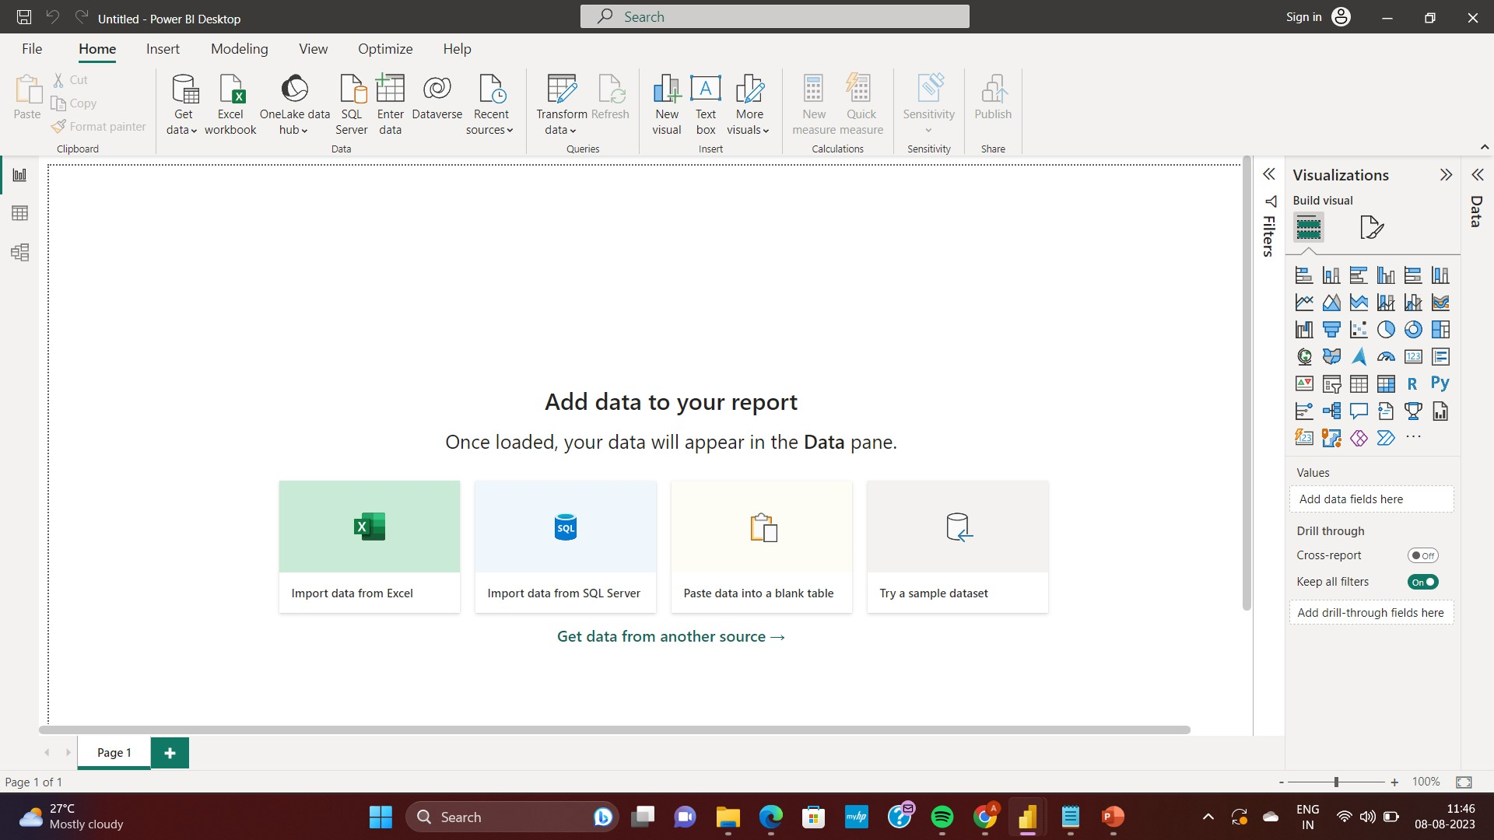
Overview of Power BI Interface

Slide 6
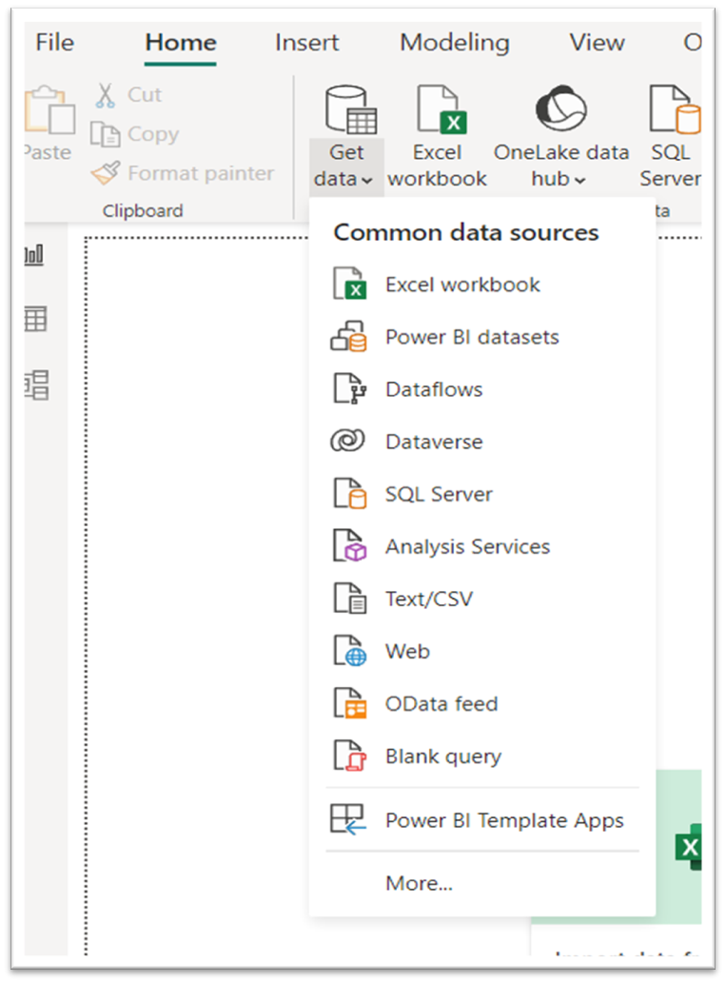
Connecting Data Sources
Introduction:
With Power BI Desktop, you can connect to many different types of data. These sources include basic data sources, such as a Microsoft Excel file. You can connect to online services that contain all sorts of data, such as Salesforce, Microsoft Dynamics, Azure Blob Storage, and many more.
Get Data :
Home Tab Get data

Slide 7
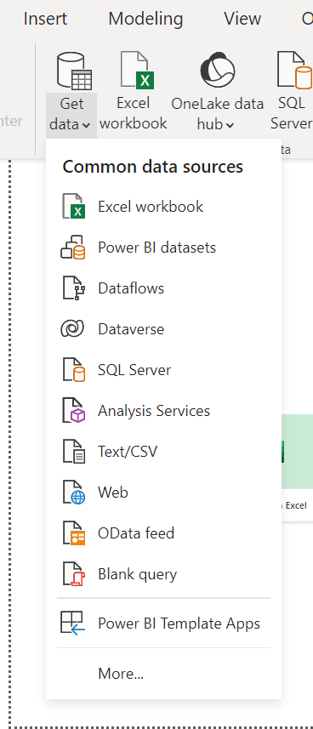
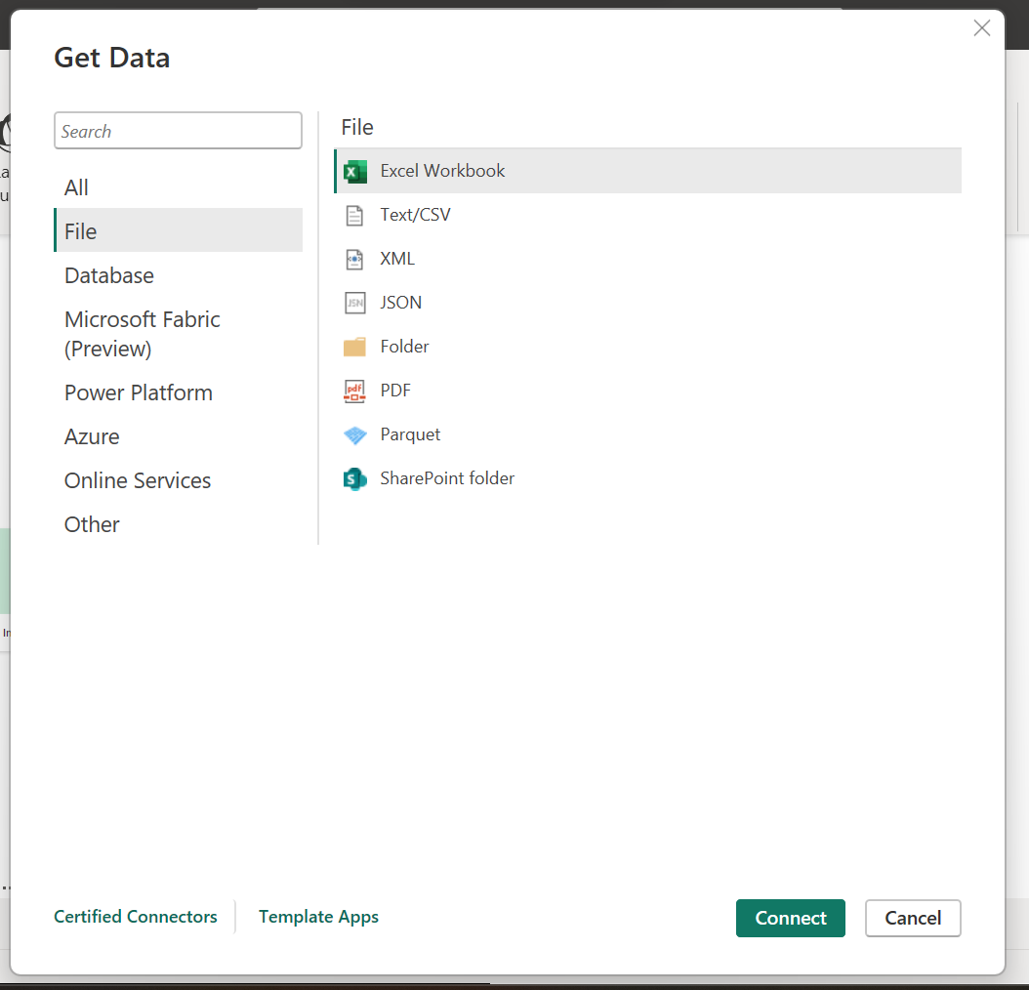
Data Source
Common Data Source
More Option

Slide 8
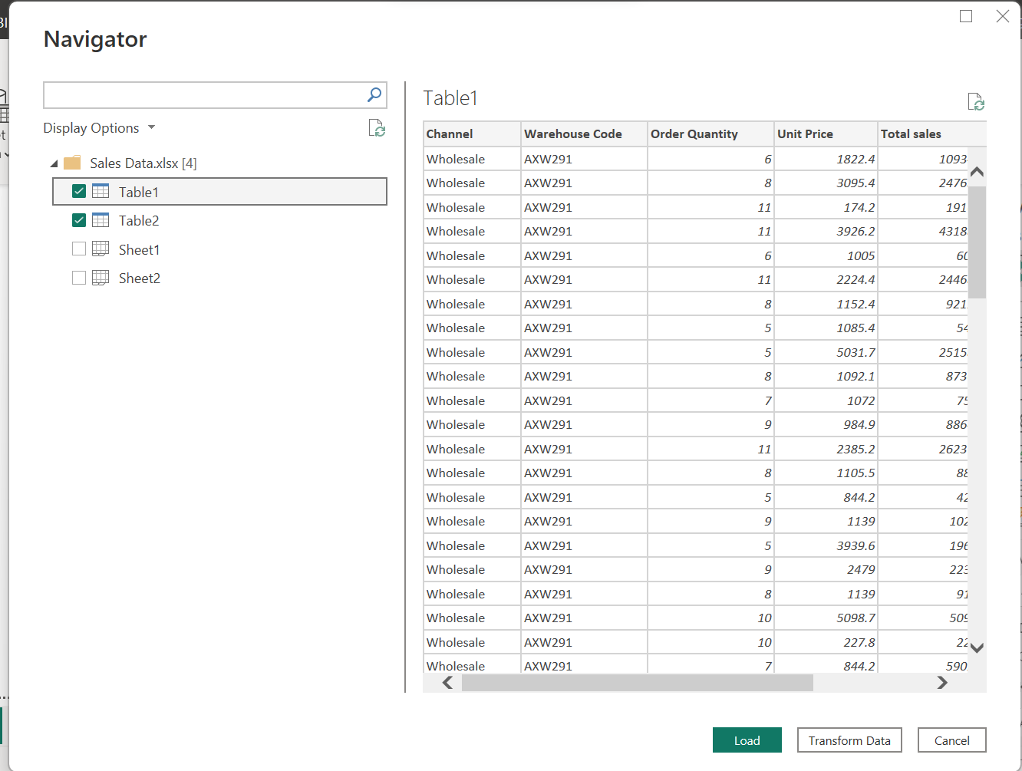
Get Data
Home Ribbon Get Data
Navigator

Slide 9
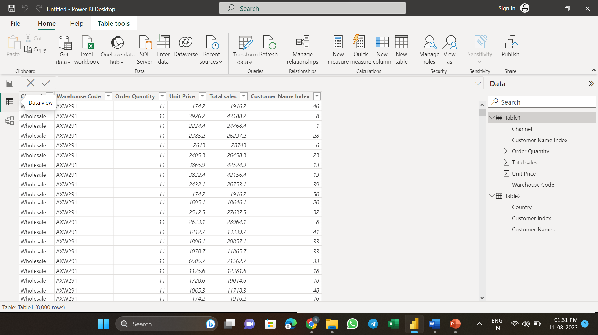
View Data In Field Panes

Slide 10
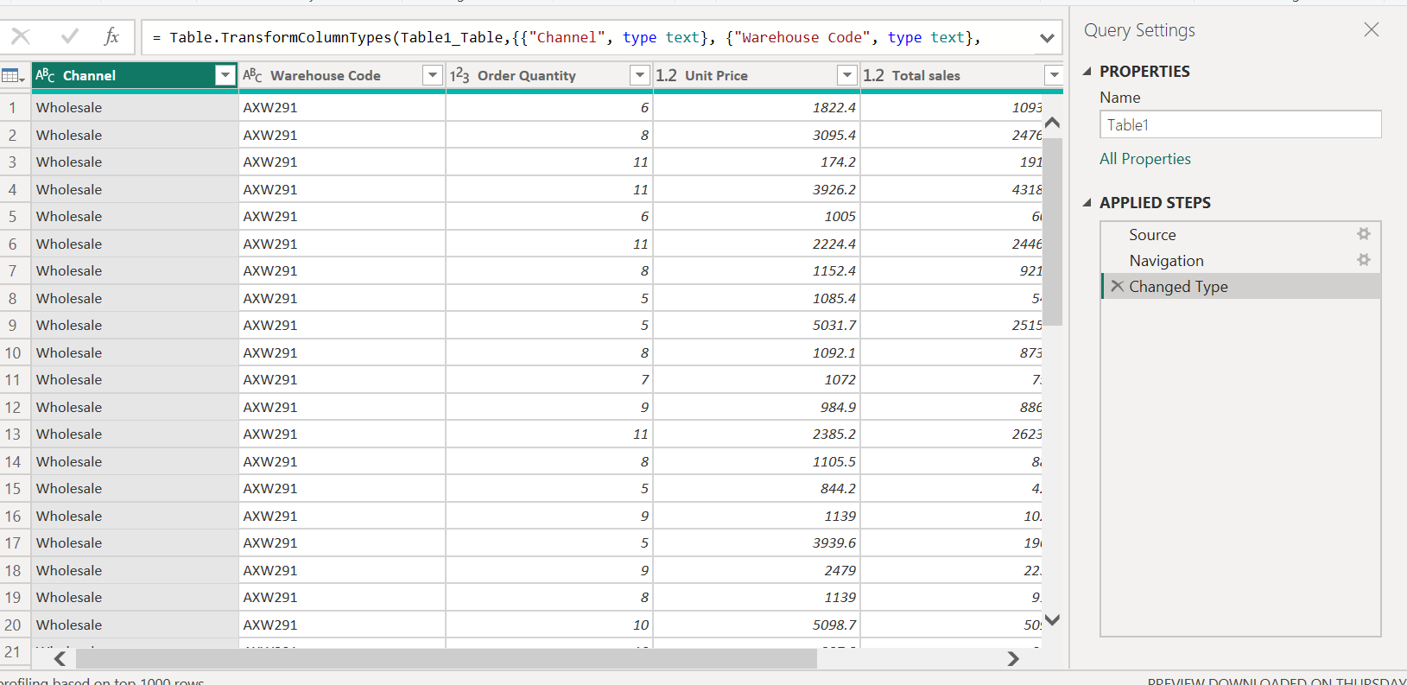
Transform Data
Data View
Home Ribbon
Transform Data
Query Editor:
Power BI's Query Editor provides a visual interface to clean and shape data.
Filter, merge, transform, and pivot data for analysis.
Applied Steps:
Each transformation in Query Editor is recorded as an applied step.
Easily modify or undo steps to refine your data.

Slide 11
Conclusion
Connecting data sources in Power BI is a fundamental step that empowers you to unlock insights from diverse datasets. Whether it's a local file, a cloud-based service, or a database, Power BI's intuitive interface and powerful features enable you to seamlessly connect, transform, and visualize data for informed decision-making.

Slide 12
Creating Basic Visualizations
Bar charts
Column Charts
Line charts
Pie charts

Slide 13
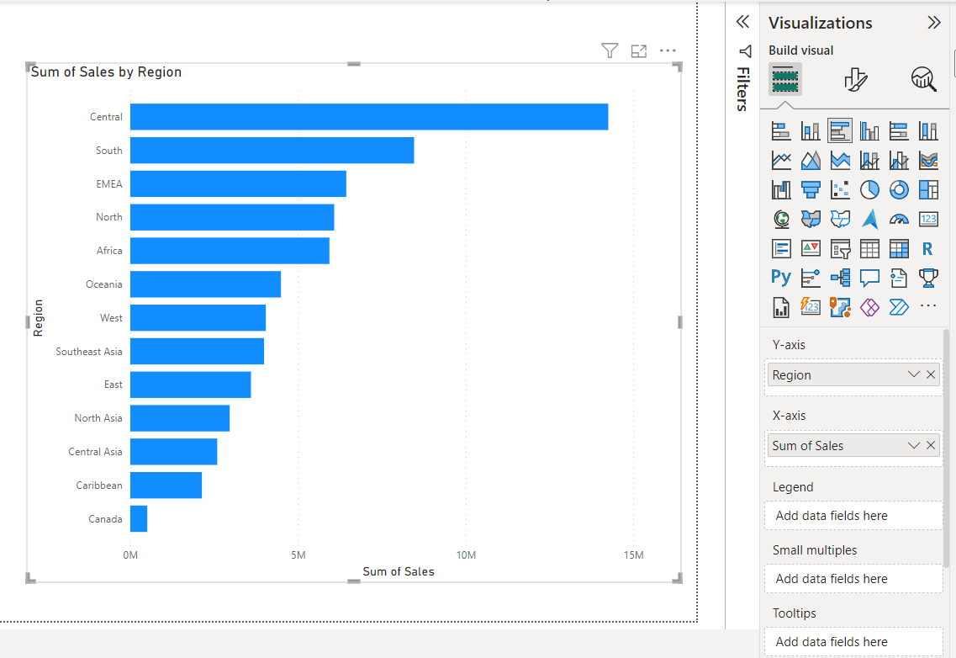
Bar Chart
X- axis - Drag a categorical field
Y- axis - Drag a numerical field

Slide 14
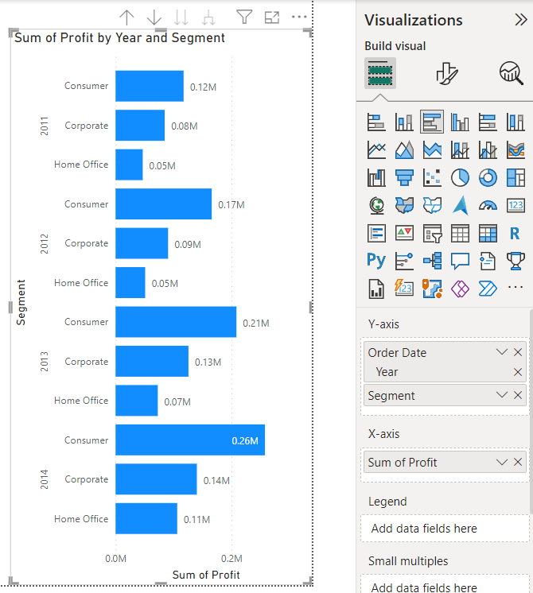
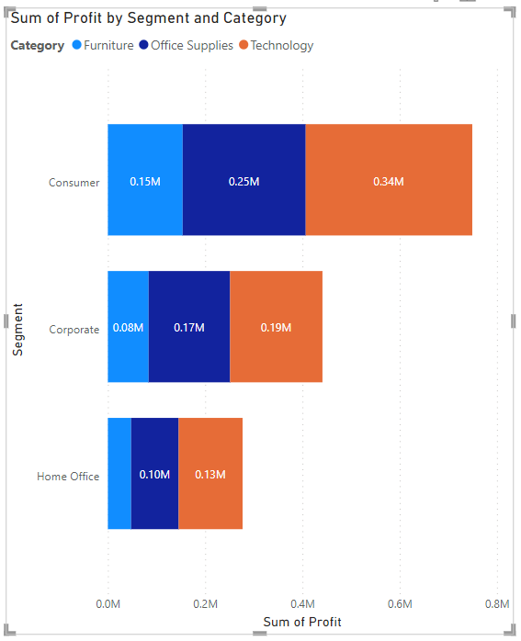
Variations of Bar Chart
Clustered bar chart
Stacked bar chart

Slide 15
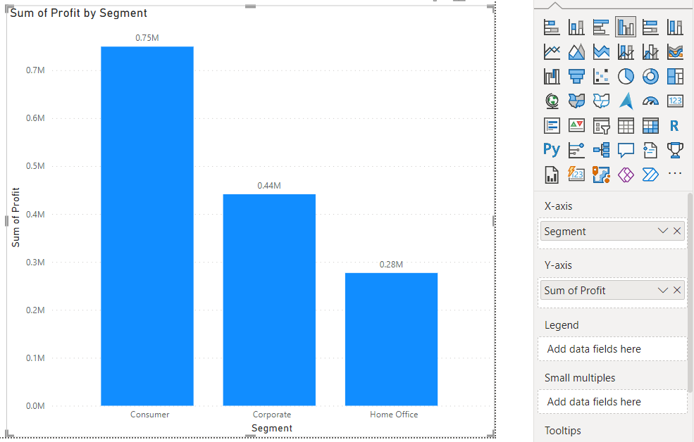
Column chart
X-axis : categorical Field
Y-axis : Numerical Field

Slide 16
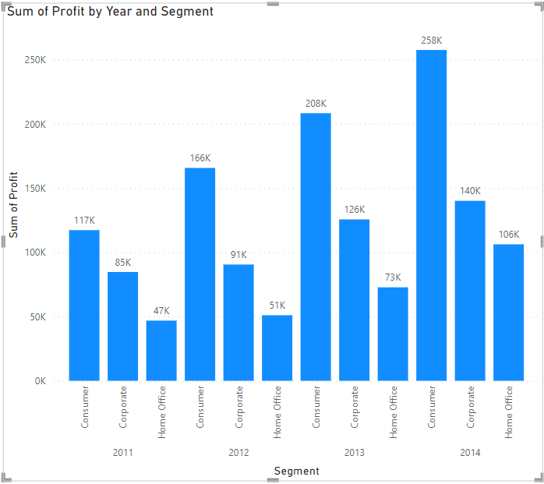
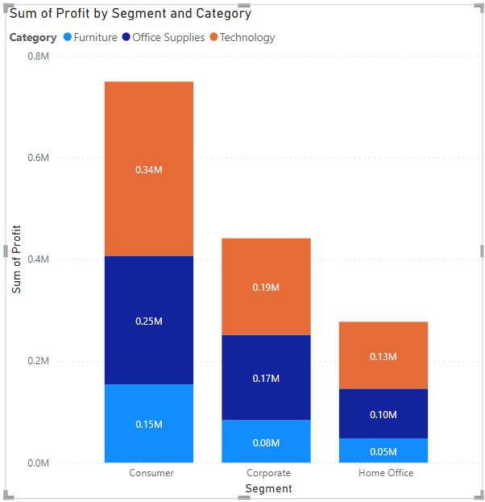
Variations of Column Chart
Clustered Column Chart
Stacked Column Chart

Slide 17
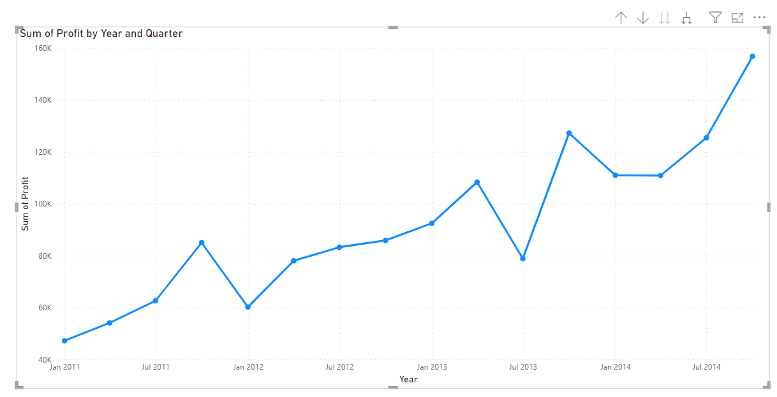
Line Chart
Choose a timeline-based or numerical dataset.
X-Axis : timeline - based field
Y- axis : numerical field.

Slide 18
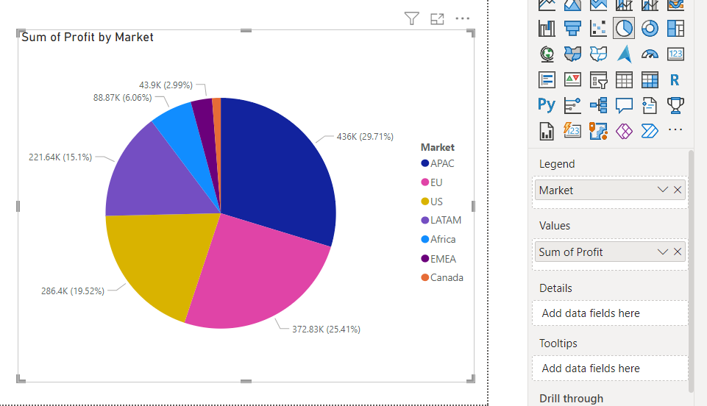
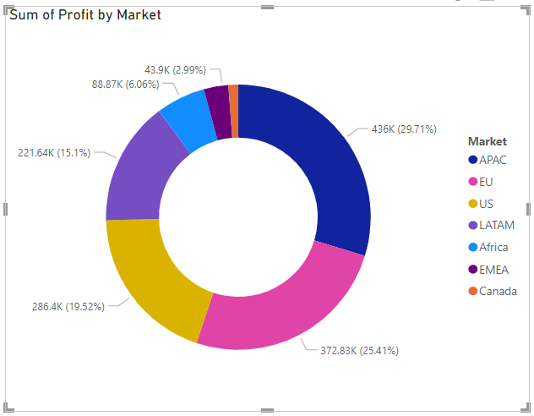
Pie Chart & Do
Pick a categorical dataset
Legend - Categorical field
Values – Numerical field

Slide 19
Conclusion
Creating basic visualizations in Power BI is a straightforward process.
Enables us to represent data vividly and extract insights.

Slide 20
Customizing Visualizations
Introduction:
Customizing visualizations is essential to enhance their visual appeal and effectively convey insights. Power BI provides a range of formatting options that allow you to tailor the appearance of your visuals. Let's explore how to customize visualizations using formatting options, including changing colors, fonts, and labels

Slide 21
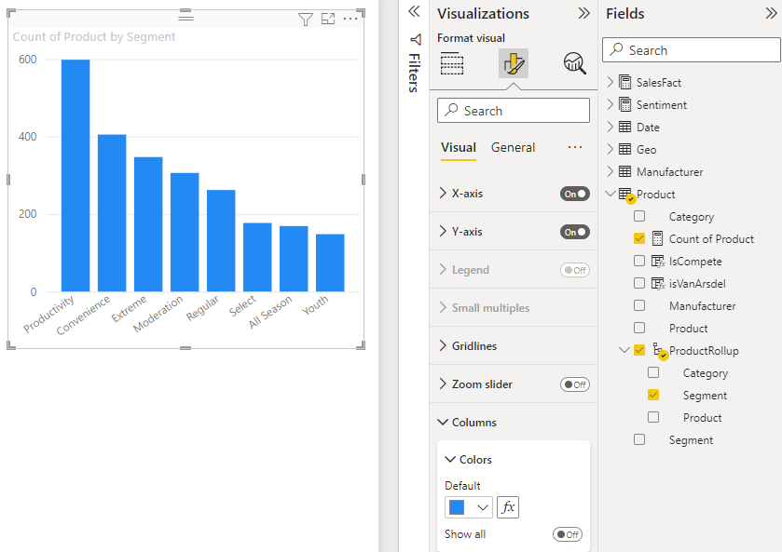
Changing Colors
Select the Visualization:
Click on the visualization you want to customize.
Format Pane:
Open the "Format" pane from the right-hand side.
Navigate through options like Data colors, Background, and Title.
Color Palette:
Choose from predefined color palettes or create a custom color scheme.

Slide 22
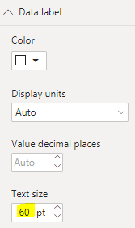
Adjusting Fonts
Format Pane - Fonts:
In the "Format" pane, go to the "Fonts" section.
Modify font styles, sizes, and colors for various elements.
Title and Labels:
Customize font settings for titles, axis labels, and data labels.

Slide 23
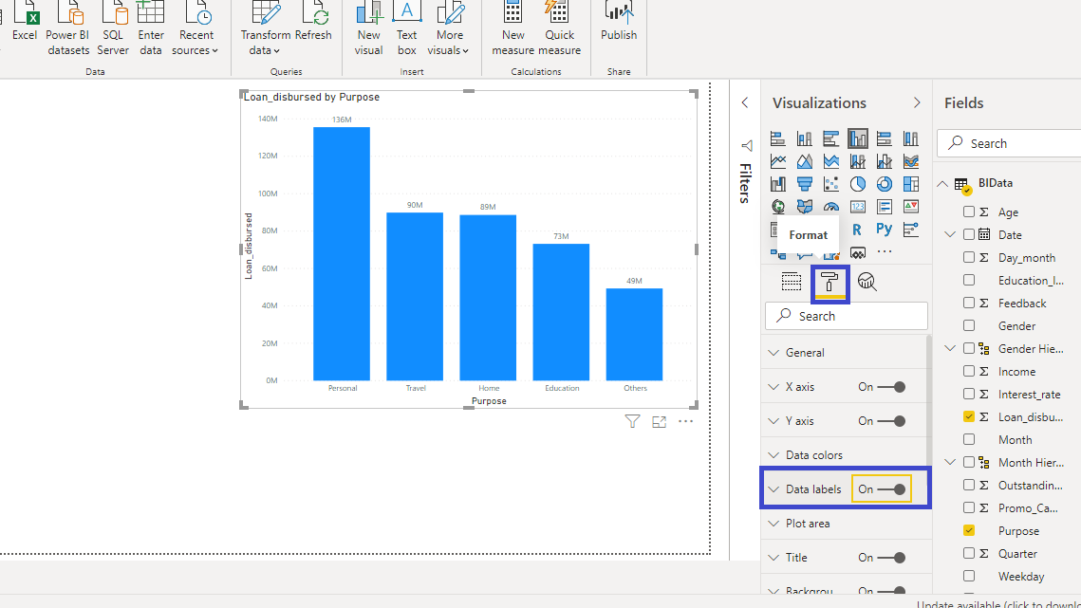
Label Customization
Data Labels:
Toggle data labels on or off for individual data points.
Customize data label position, font, and format.
Axis Labels:
Format axis labels to display as needed (date formats, numeric formats).

Slide 24
Shapes and Lines & Animations
Enhance visuals by adding shapes, lines, or text boxes.
Customize their appearance using the "Format" pane.
Add animation effects to enhance user engagement.
Control animation duration and direction in the "Format" pane.

Slide 25
Conclusion
Customizing visualizations in Power BI offers the flexibility to align your visuals with your brand identity and improve the overall clarity of your data presentation. Experiment with different formatting options to create compelling and engaging visualizations that effectively communicate insights to your audience.

Slide 26
Adding Filters and Slicers
Introduction:
Filters and slicers are powerful tools that enhance interactivity and facilitate data exploration in Power BI. They allow users to focus on specific aspects of the data, enabling dynamic filtering and deeper analysis. Let's explore how filters and slicers work, their importance, and how to incorporate them into your visualizations.

Slide 27
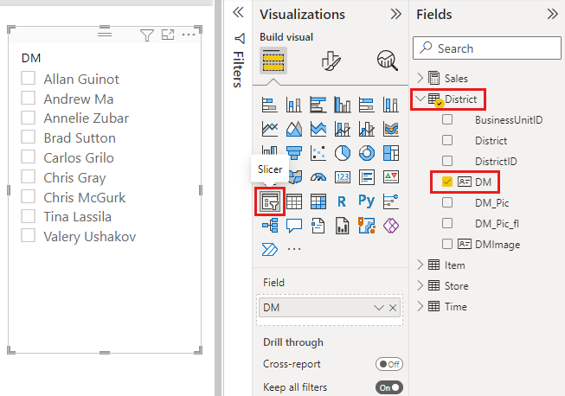
Adding a slicer:

Slide 28
Creating Interactive Dashboards
Introduction:
Dashboards are dynamic and interactive canvases that consolidate multiple visualizations into a unified view. They provide a holistic snapshot of data, enabling users to explore insights, identify trends, and make informed decisions. Let's delve into the concept of dashboards and their significance, followed by a step-by-step guide on creating an interactive dashboard in Power BI.

Slide 29
Steps for creating dashboard:
1.Open power BI
2. Create or import reports
3. Add visualizations to reports
4. Save reports
5. Create a new dashboard
6. Customize the dashboard
7.Save the dashboard
8. Publish to Power BI Service

Slide 30
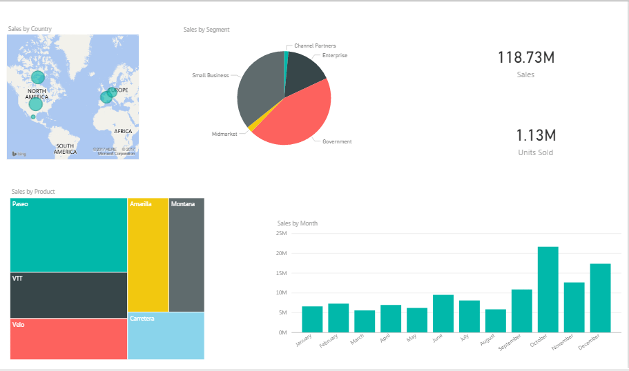
Dashboard:

Slide 31
THANK YOU ALL

